Slide 2
Part 1
Background

Slide 3
个 人 空 间
Personal Space

Slide 4

Bubble

Slide 5
Personal space is the area immediately surrounding an individual, sometimes described as an imaginary “bubble”
Most people are very aware of others in “their space” and many require the area to remain relatively clear in order to feel at ease.
The idea of personal space is rooted in psychology, and there are many theories about how the space develops and how people react to violations.
Some of this is based on genetics and brain chemistry, but a lot is also cultural.
个人空间是紧邻个人周围的区域，有时被描述为想象中的“泡泡”。大多数人都非常清楚“他们的空间”中的其他人，许多人要求这个区域保持相对清晰，这样才能感到轻松自在。个人空间的概念植根于心理学，关于空间是如何发展的，以及人们如何应对违规行为，有很多理论。这其中有一部分是基于遗传学和脑化学的，但也有很多是文化方面的。
—— J.Gunsch

Slide 6
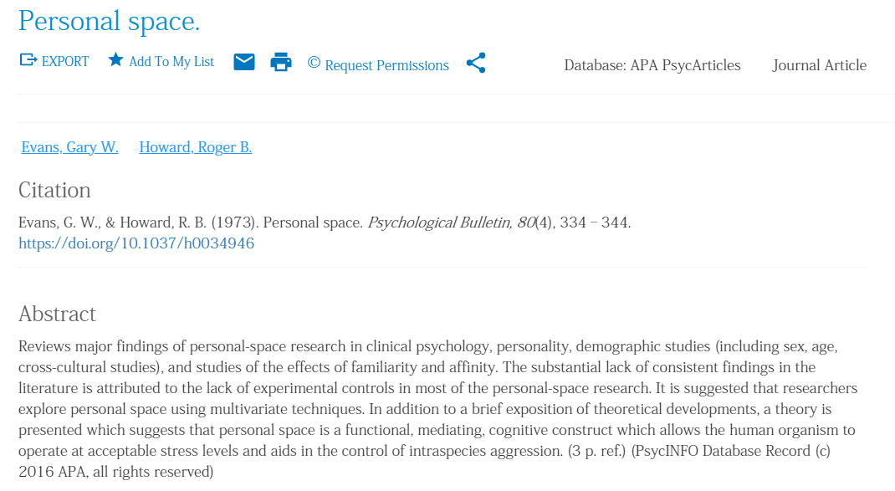
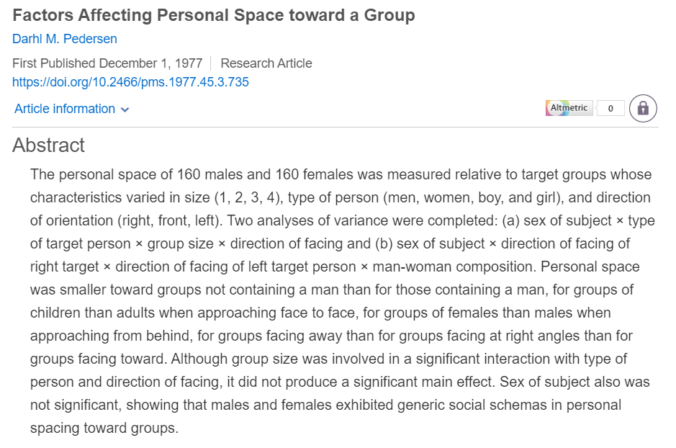
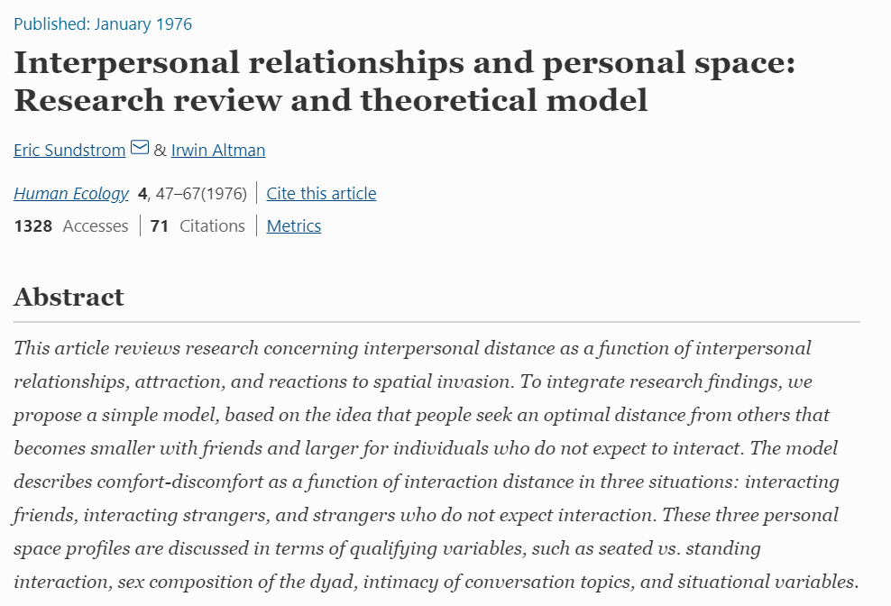
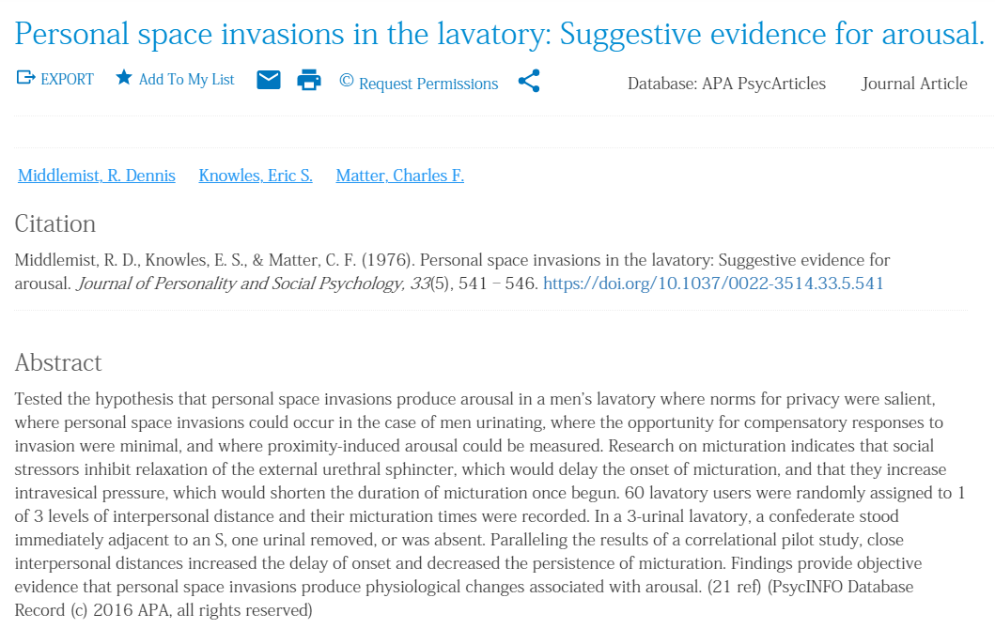
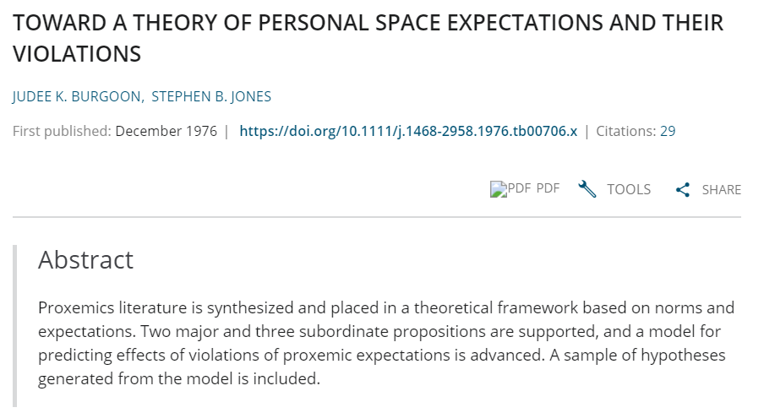
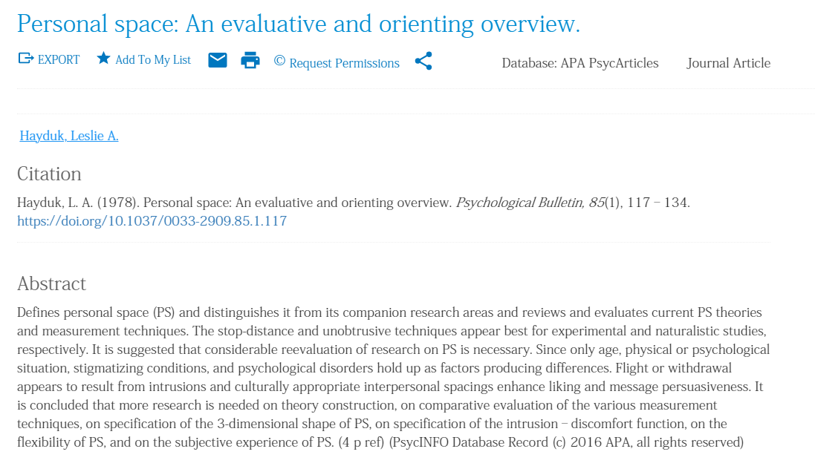
1970s

Slide 7
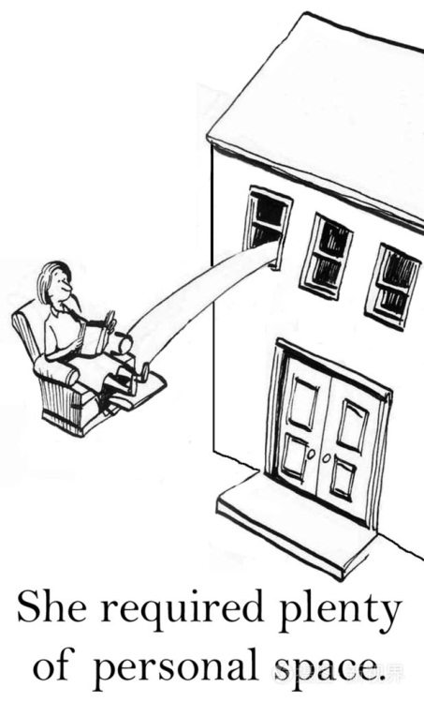

Slide 8
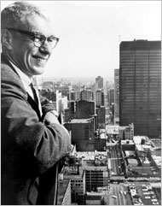
Edward T.Hall

Slide 9
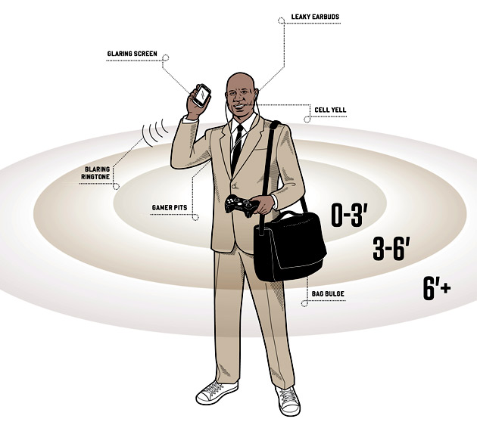
Dr. Edward Hall, an American anthropologist, believes that according to the different degrees of people's relationships, individual space can be divided into four distances, namely, intimacy, personal, social and public.

Slide 10
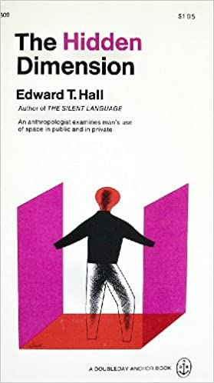
Intimacy
Personal
4 distances
Social
Public

Slide 11
1
亲密距离
这种距离是人际交往中最小的间距。处于0～15厘米之间，彼此可以肌肤相触，耳鬓厮磨，属于亲密接触关系。处于15～45厘米，这是身体不相接触，但可以用手相互摸触到的距离，如挽臂执手，促膝倾谈等，多半用于兄弟姐妹、亲密朋友之间，是个人身体可以支配的势力圈

Slide 12
2
个人距离
这种距离较少直接身体接触。处于45—75厘米之间，适合在较为熟悉的人们之间，可以亲切的握手、交谈;或者向他人挑衅也在这个距离中进行。处于75～120厘米之间，这是双方手腕伸直，可以互触手指的距离，也是个人身体可以支配的势力圈。

Slide 13
3
社交距离
这种距离已经超出亲密或熟悉的人际关系。处于120～210厘米之间，一般是工作场合和公共场所
处于210—360厘米之间，表现为更加正式的交往关系，是会晤、谈判或公事上所采用的距离，首长接见外宾或内宾;大公司的总经理与下属谈话等，由于身份的关系需要与部下之间保持一定的距离

Slide 14
4
公共距离
这种距离人际沟通大大减小，很难进行直接交谈。处于360～750厘米之间，这是产生势力圈意识的最大距离。处于750厘米以上距离位置，在现代社会中，则是在大会堂发言、演讲、戏剧表演、电影放映时与观众保持的距离。

Slide 15

TVB 《读心神探》第一集

Slide 16
People need private space more than before, but now people are constantly invading other people's private forties. so the author wrote this article to analyze the reasons for the invasion and finally express that he will pay more attention to protecting other people's private space

Slide 17
Part 2
Writer

Slide 18

Richard Stengel

Slide 19

Editor
Author
Time magazine‘s managing editor
Chief executive of the National Constitution
Under Secretary of State

Slide 20
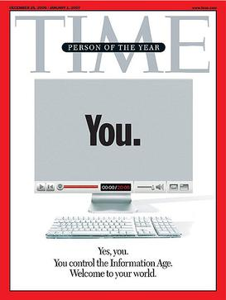
Notes:
2006年年度人物封面
Stengel selected "You" — short for user-generated-content — as Time's "Person of the Year", which was the subject of much media coverage and debate.

Slide 21
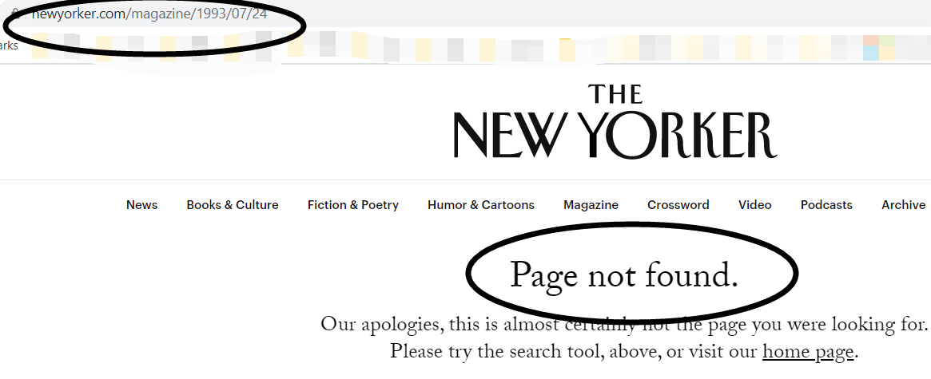

Slide 22
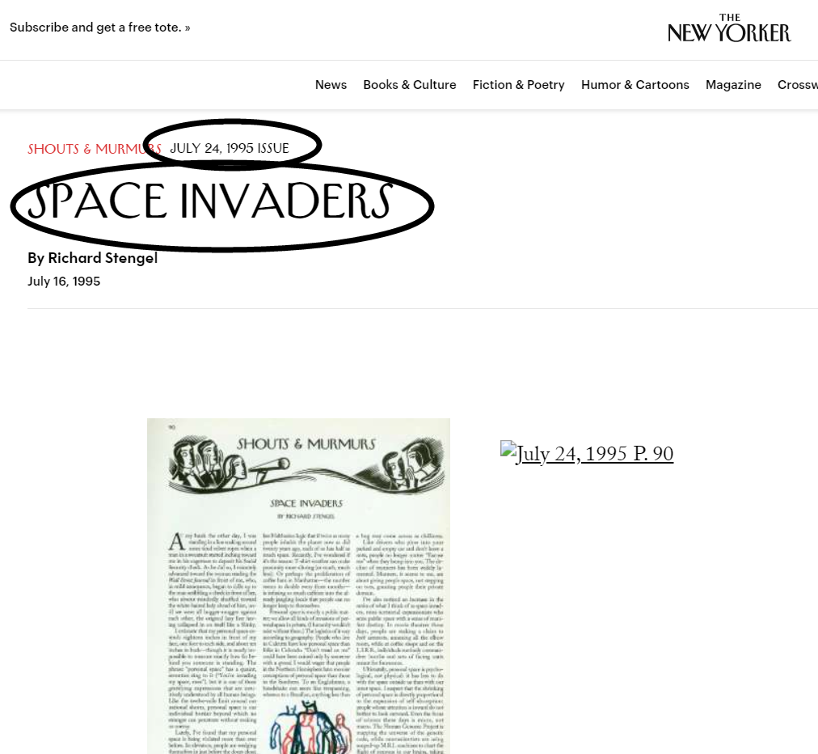

Slide 23
Part 2
Notes

Slide 24

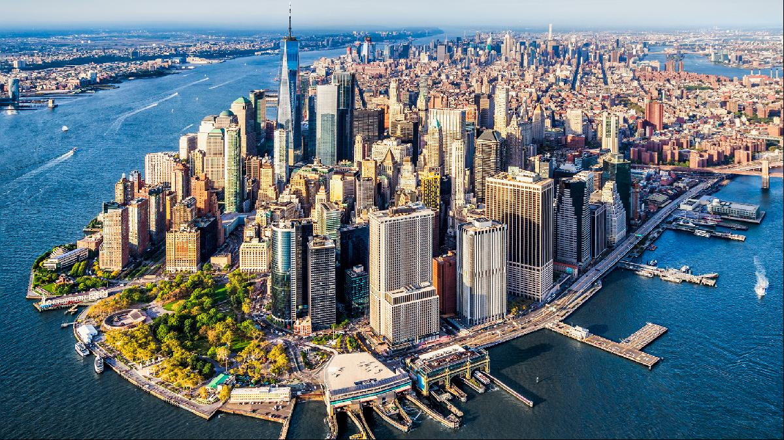


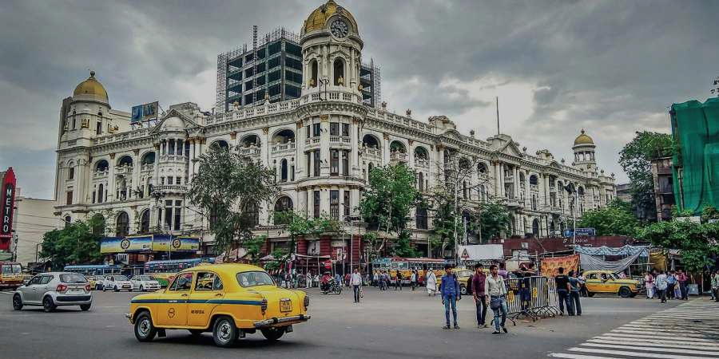
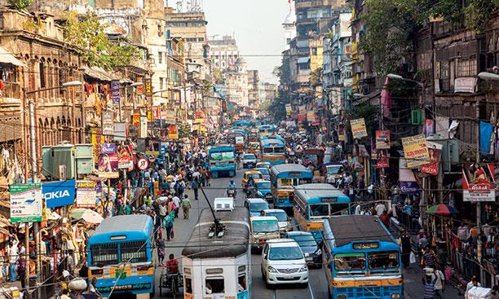




An island in southeastern New York City. The New York City boroughs of Brooklyn and Queens are at its west end
Former capital of British India. It is the largest city in India and also the most populous one, with about 10 million people living in an area of 1,300 square kilometers
Manhattan is the most densely populated district among the five boroughs of New York City.
It is known as the economic center of the world. It is also the richest district in New York
A state located in the mid-west of the U.S. It has a population of less than 5 million
Manhattan
The Long Island Railroad (LIRR) provides rail service to residents of Long Island, New York, and New York City.
Officially opened on April 24, 1834, the Long Island Railroad is the oldest rail system in the United States still under its original name, and the busiest commuter railroad in the United States
Calcutta
Colorado
Long Island

Slide 25
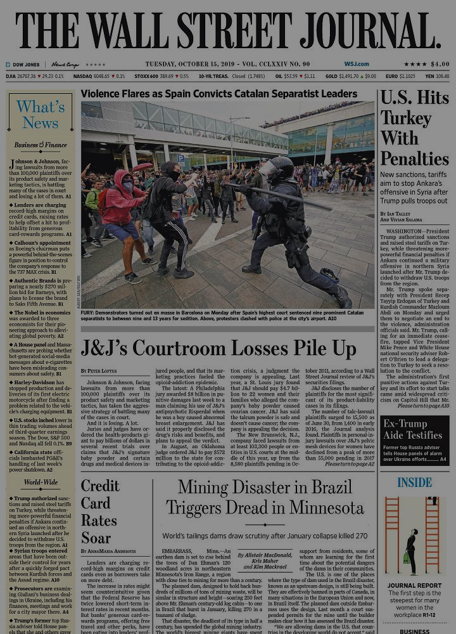


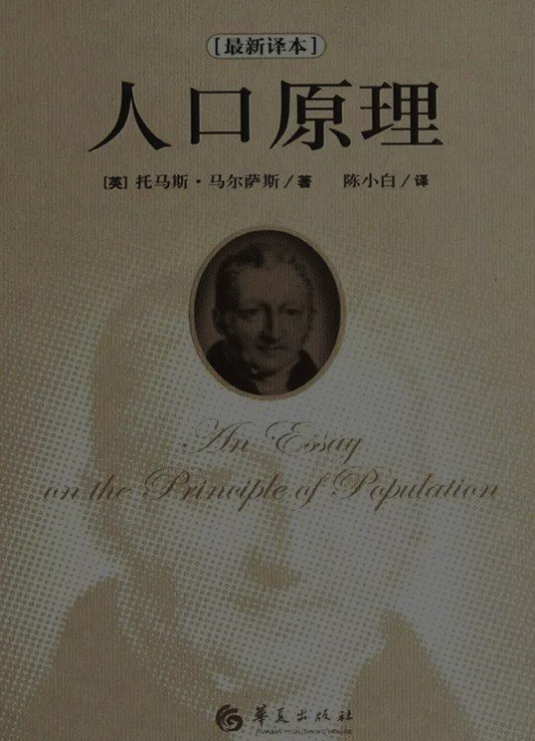
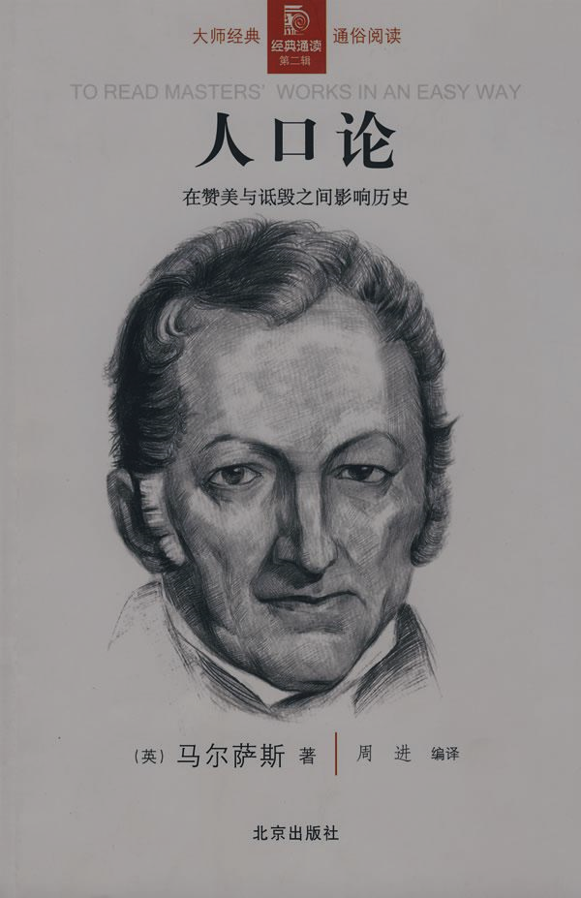


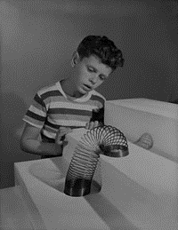
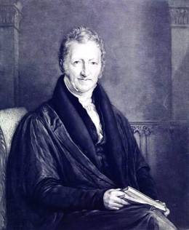
Malthusian logic
(马尔萨斯逻辑)
Publishing house: Dow Jone&Company
Time: 1889
A kind of financial newspaper
( The largest paid circulation financial newspaper in the United States)
City: New York, U.S
Main Reader: political, economic, educational and medical professionals, financial tycoons and managers, and stock market investors
Slinky （机灵鬼）
Is a kind of coiled spring toy.
Inventor: Richard James ( a mechanical engineer)
Time: In the early 1940s
（One of the most memorable and creative toys of the 20th century）
Usage: If you put it on a staircase, it will continue to stretch and recover along the stairs under the combined action of gravity and inertia, showing the interesting state of "going down the stairs"
20世纪最值得纪念和最具创造力的一种螺旋式弹簧玩具。
Thomas Robert Malthus (托马斯·罗伯特·马尔萨斯)
Wall Street Journal
In essay on Population (1798) he argued that without the practice of moral restraint" the population tends to increase at a greater rate than its means of subsistence, unless war, famine, or disease intervenes or efforts are made to limit population.
Time：1766—1834
Country: Britain
Clergyman, Demographer and Political economist
He is famous for his theory of population
Slinky
The Wall Street Journal is a comprehensive newspaper featuring financial reporting, focusing on the financial and business fields. It has a wide international influence, with a daily circulation of 2 million. It is also published in Asia, Europe and online, with a daily readership of more than 20 million people.
在《论人口》(1798)一文中，马尔萨斯认为，如果不实行道德约束，“除非战争、饥荒或疾病进行干预，或采取措施限制人口，否则人口增长的速度将超过其生存手段。”
Malthusian logic

Slide 26

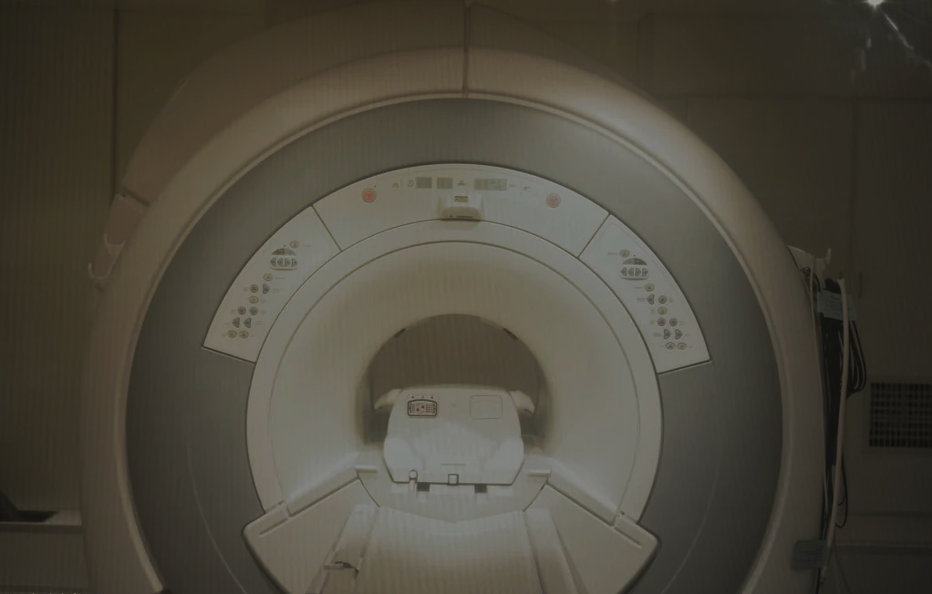

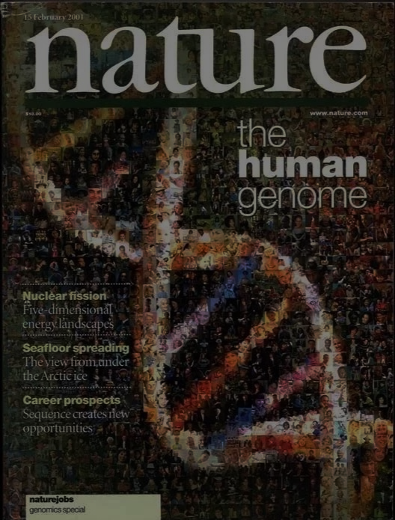

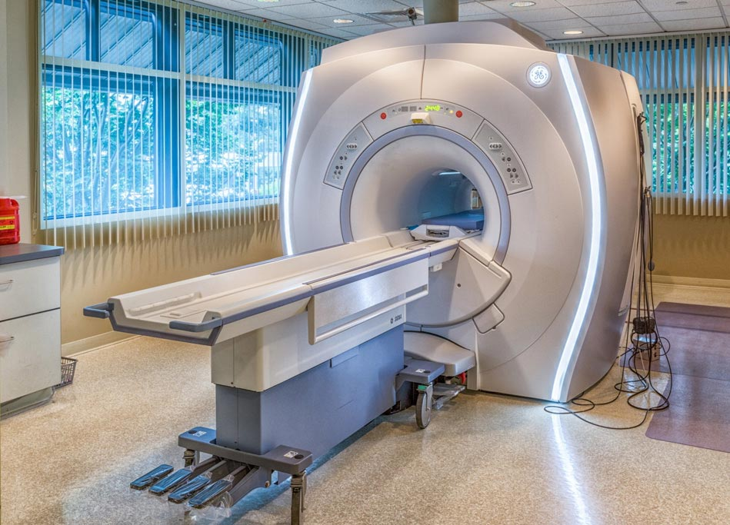
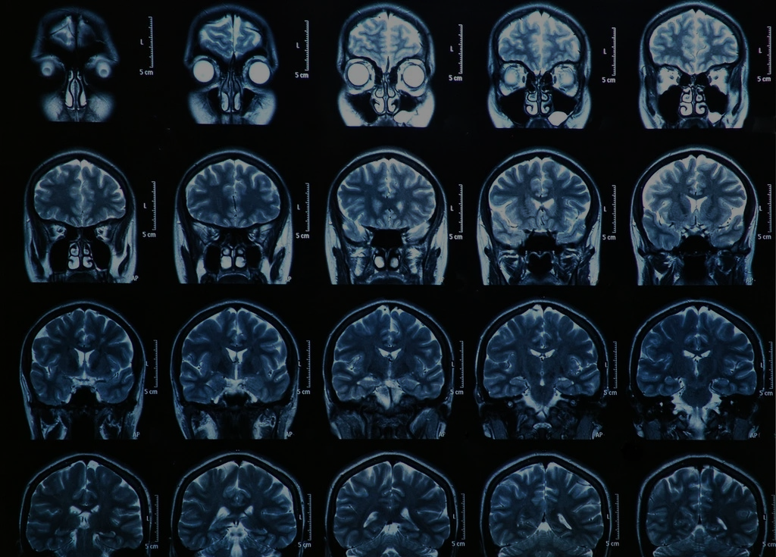


Time: in 1990
Countries: the US, the UK, France, Germany, Japan, and China
Goal: to provide researchers with powerful tools to understand the genetic factors in human diseases, paving the way for new strategies for their diagnosis, treatment and prevention
Three major scientific projects：the Human Genome Project
the Manhattan Atomic Bomb Program
the Project Apollo
•magnetic resonance imaging（磁共振成像）
•An imaging technique that uses electromagnetic radiation to obtain images of the body's soft tissues.
•Application fields: physics, chemistry, medical, petrochemical, archaeology....
•磁共振成像,利用核磁共振原理,通过外加梯度磁场检测所发射出的电磁波,据此可以绘制成物体内部的结构图像,在物理、化学、医疗、石油化工、考古等方面获得了广泛的应用。
the Human
Genome Project
•In the same way that the breeze from a butterfly's wings in Japan may eventually produce a tidal wave in California. (Paragraph 9)
•The phenomenon that a minute localized change in a complex system can have large effects elsewhere.
•蝴蝶效应是指在一个动力系统中,初始条件下微小的变化能带动整个系统的长期的巨大的连锁反应。这是一种混沌现象。
M.R.I.
人类基因组计划,由美国科学家于1985年率先提出,于1990年正式启动。美、英、法、德、日和我国科学家共同参与了这一预算达30亿美元的人类基因组计划。按照这个计划的设想,在2005年,要把人体内约10万个基因的密码全部解开,同时绘制出人类基因的谱图。换句话说,就是要揭开组成人体4万个基因的30亿个碱基对的秘密。人类基因组计划与曼哈顿原子弹计划和阿波罗计划并称为三大科学计划。
Butterfly Effect

Slide 27
End

